Slide 1

NYC Citi Bike Demand: A Big Data Exploratory Analysis & Advanced Interactive Dashboard
Leveraging Cloud Processing, Advanced Visualization, and Statistical Insights
Ashish Bheemudu | MS Data Science Capstone Project, Pace University | October 22, 2025

Slide 2

Problem Statement & Dataset
Understanding NYC Urban Mobility Challenges
• Challenge: Predict bike demand to optimize station rebalancing
• Dataset: 9.9 Million+ trip records (2019-2025)
• Coverage: 2,500+ stations across NYC boroughs
• Variables: Trip data, weather, temporal patterns, station metadata
• Goal: Enable real-time demand forecasting at station level

Slide 3
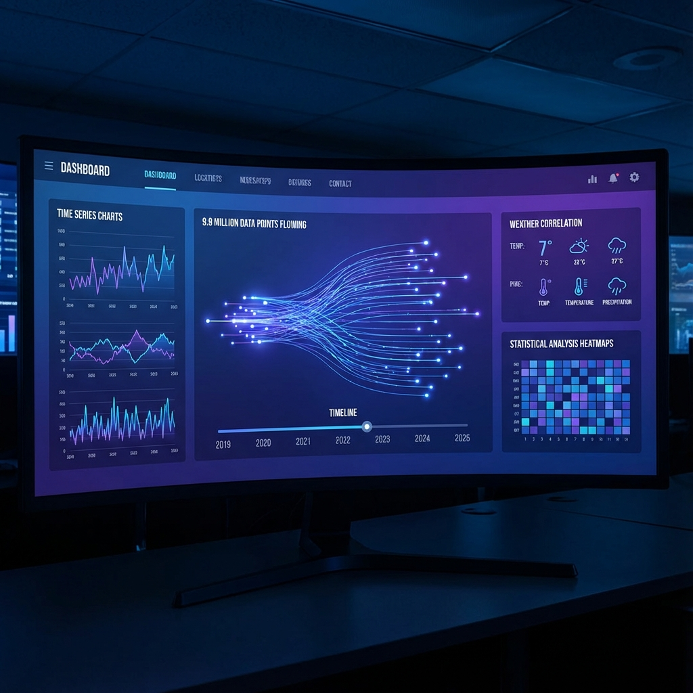
Data Processing & Feature Engineering
Big Data Pipeline & 56-Feature Architecture
• Temporal Features: Hour/day cyclical encoding, rush hour flags
• Lag Features: 1h, 6h, 24h, 168h historical demand
• Rolling Windows: 4h, 12h, 24h, 168h mean/std/min/max
• Weather Integration: Temperature, precipitation, wind speed
• Advanced: EMA, demand delta, holiday/weekend indicators

Slide 4
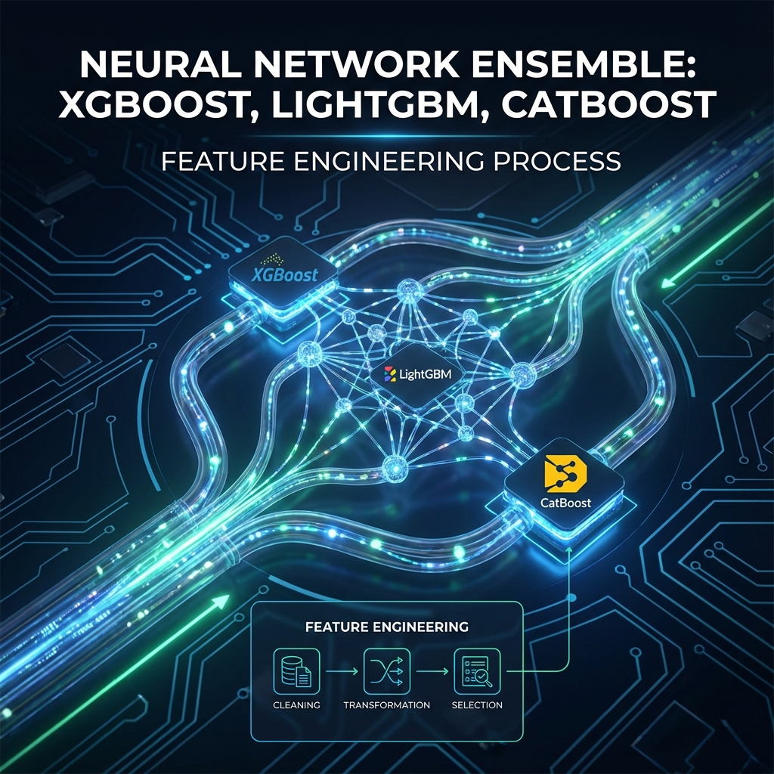
Machine Learning Architecture
Ensemble Model with Gradient Boosting
• Ensemble: XGBoost + LightGBM + CatBoost weighted voting
• Feature Scaling: StandardScaler for tree models
• Lazy Loading: Memory-optimized model serving (<1GB RAM)
• Prediction: 48-hour rolling forecast per station
• Performance: MAE ~2.1, validated on unseen 2025 data

Slide 5
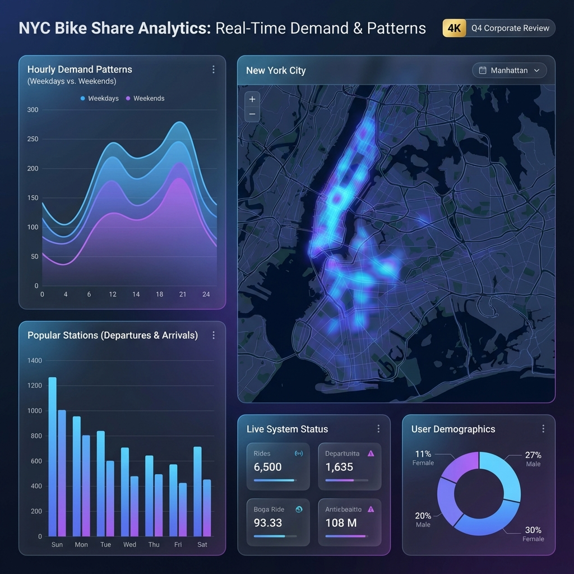
Interactive Dashboard
Real-Time Analytics & Visualization Platform
• System Overview: KPIs, weather correlation, anomaly detection
• Map Explorer: Deck.gl heatmaps, 3D hexagons, 1000+ stations
• Prediction Lab: Station-level 48-hour ML forecasts
• Station Drilldown: Hourly/daily demand profiles
• Premium UI: Glassmorphism, Framer Motion animations

Slide 6
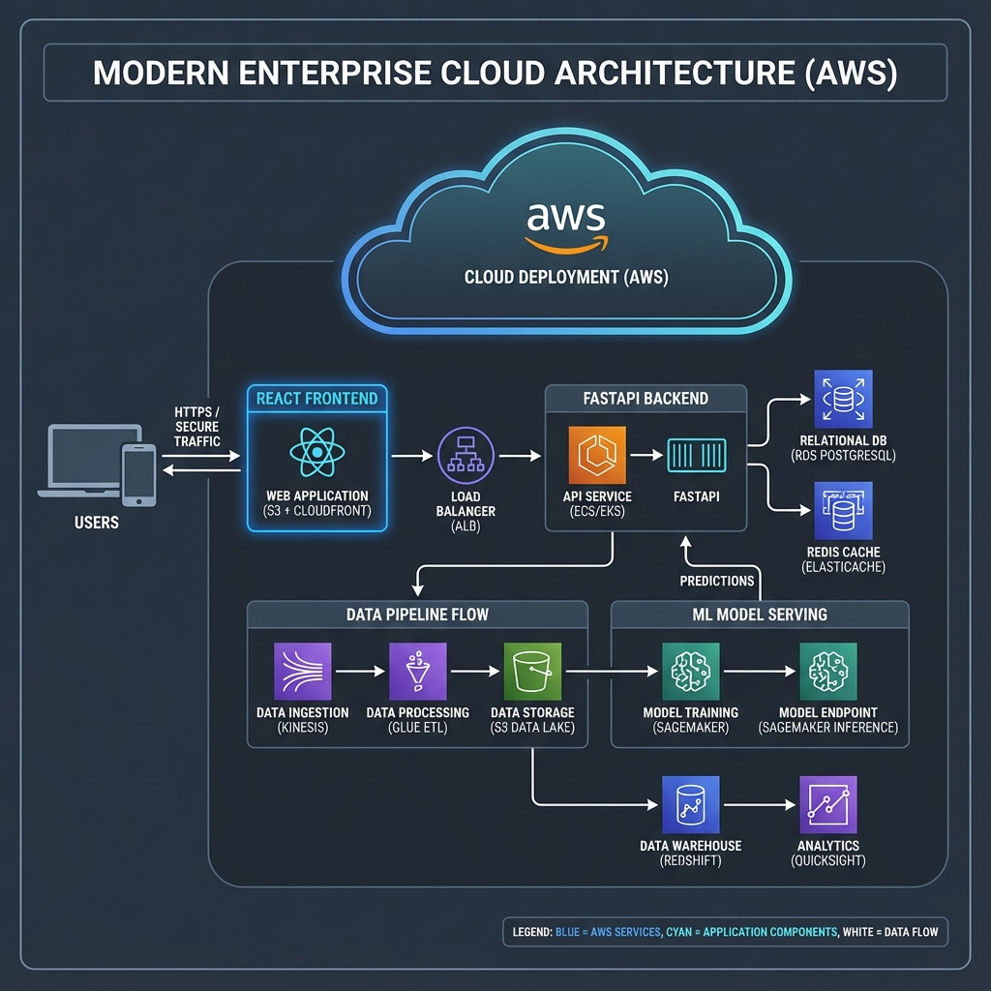
Technology Stack & Deployment
Cloud-Native Full-Stack Architecture
• Backend: FastAPI (Python) - 20+ REST endpoints
• Frontend: React + Vite + TailwindCSS + Recharts
• Mapping: Deck.gl + MapLibre GL for geospatial viz
• Cloud: AWS EC2 with Docker Compose deployment
• Data: Parquet files for optimized big data loading

Slide 7
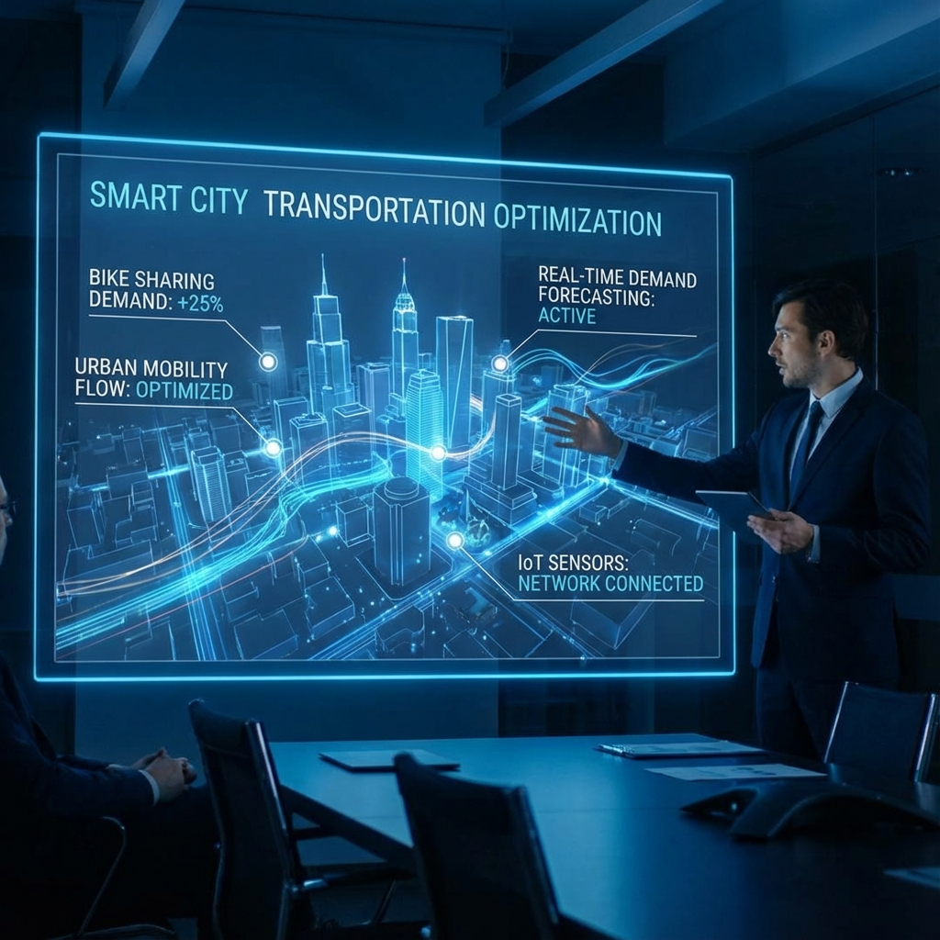
Results & Future Scope
Impact & Next Steps
• ✓ Real-time predictions for 2,500+ NYC bike stations
• ✓ Weather-aware demand forecasting (temp/precip impact)
• ✓ Production-ready AWS deployment with 24/7 uptime
• → Future: Reinforcement learning for rebalancing
• → Future: Digital twin simulation, equity analysis

